Slide 1





STUDENT NAME: P Arumugam
REGISTER NO: 422200006
DEPARTMENT: B. COM[ISM]
COLLEGE:S.I.V.E.T COLLEGE
1
Notes:
1

Slide 2

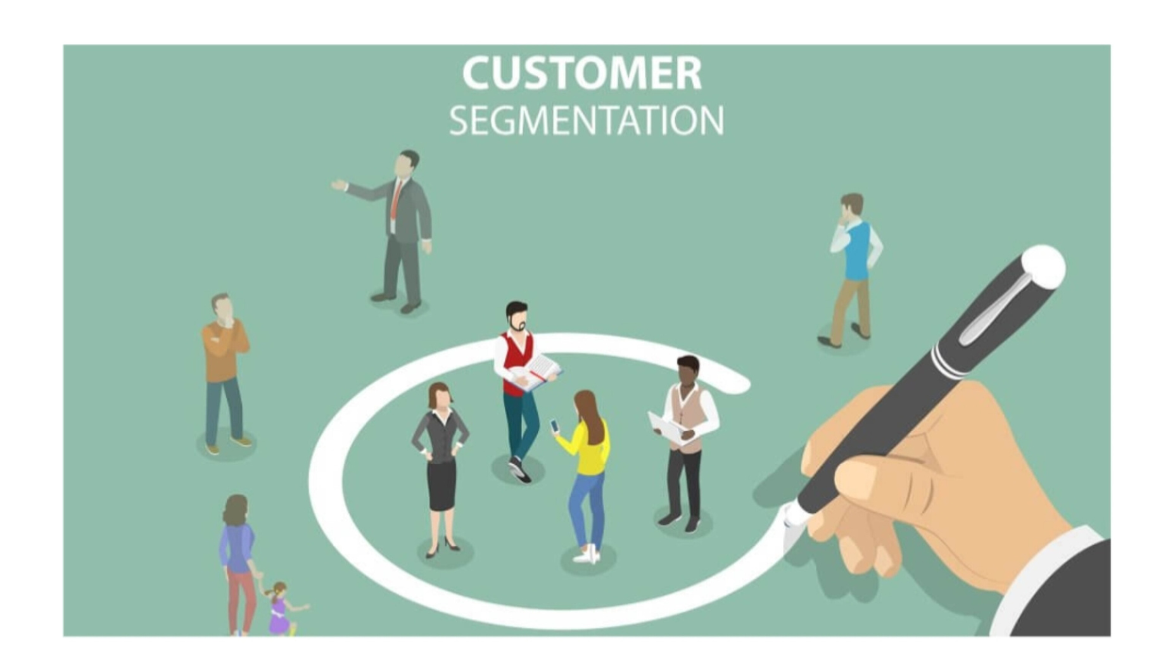
PROJECT TITLE
CUSTOMER SEGMENTATION
2
Notes:
2

Slide 3


AGENDA
Problem Statement
Project Overview
End Users
Our Solution and Proposition
Dataset Description
Modelling Approach
Results and Discussion
Conclusion
3/21/2024 Annual Review
3
Notes:
3

Slide 4

PROBLEM STATEMENT
A problem statement for customer segmentation can be about identifying patterns in customer behavior or finding segments of customers with similar characteristics.
4
Notes:
4

Slide 5

PROJECT OVERVIEW
customer segmentation project involves dividing a company's customers into groups based on shared characteristics, such as demographics, interests, or behaviors. Etc....
5
Notes:
5

Slide 6

WHO ARE THE END USERS?
Segmentation is a process that helps you identify and define the unique characteristics of your users. In other words, it enables you to segment a group of people into smaller groups based on their behaviour or interests so that you can tailor your product or service to each individual.
6
Notes:
6

Slide 7
PROPOSITION
Customer segmentation is the process of dividing customers into groups based on shared characteristics, while a value proposition is a statement that explains the benefits of a product or service to a customer.
7
Notes:
7

Slide 8
Dataset Description
The dataset is designed to facilitate customer segmentation, helping businesses understand different customer groups for targeted marketing, personalized services, and improved customer retention strategie
Notes:
8

Slide 9
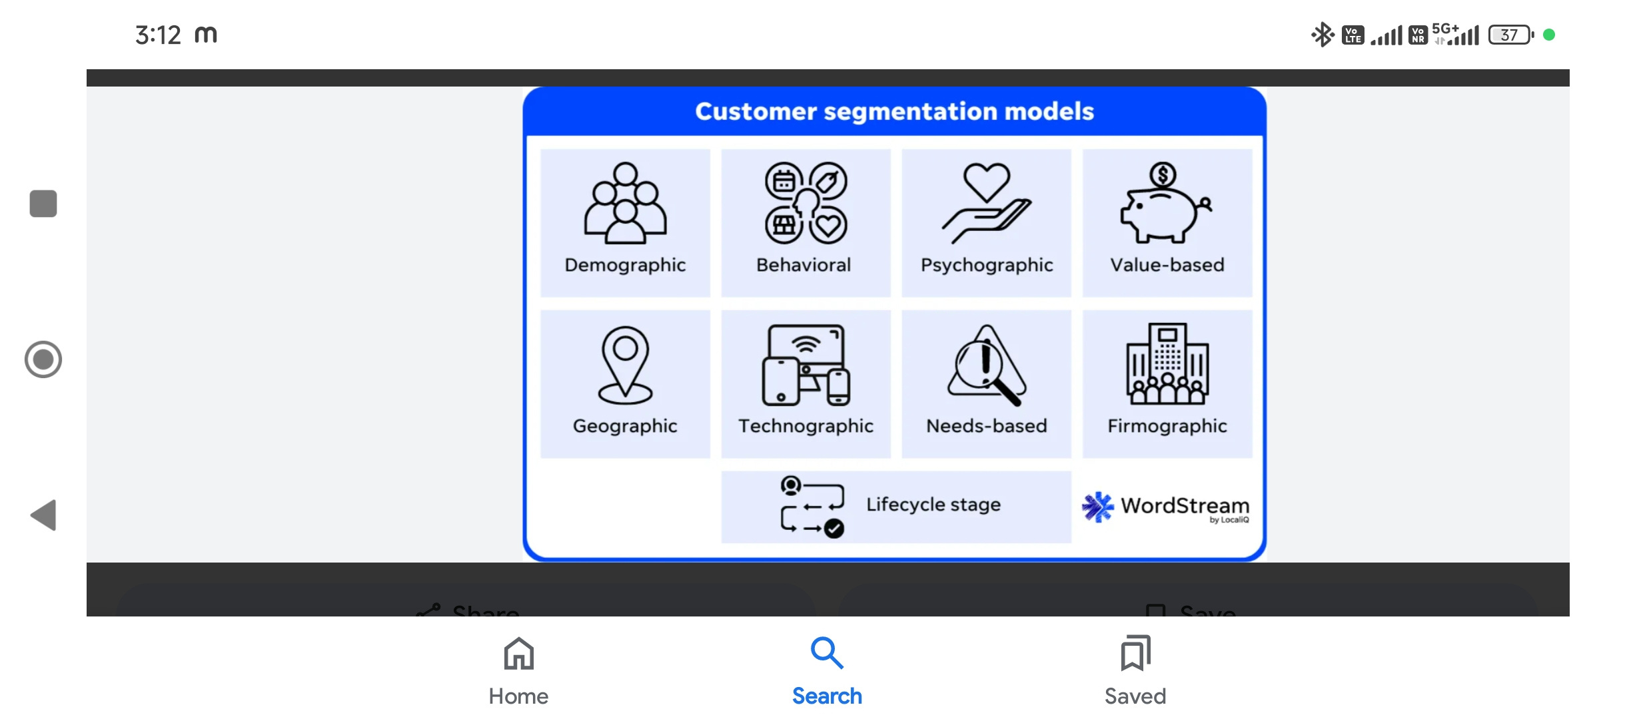
3/21/2024 Annual Review
9
Notes:
9

Slide 10
RESULTS
Enhanced customer relationship and brand loyalty: Customer segmentation shows you precisely what each customer seeks so that you can align your marketing messages and know the exact channel to use for communicating with them. It reveals customers' interests, spending habits, budgets and more to you.
11
Notes:
11

Slide 11
conclusion
Customer segmentation gives businesses the power to craft relevant marketing campaigns aligning with every group of customers. It results in improved conversion rates, increased customer engagement, and higher response rates
Notes:
12

